Slide 1
Current Challenges in genomic Data Visualization
Cydney Nielsen
BC Cancer Agency
Genome Sciences Centre
Vancouver, Canada

Slide 2
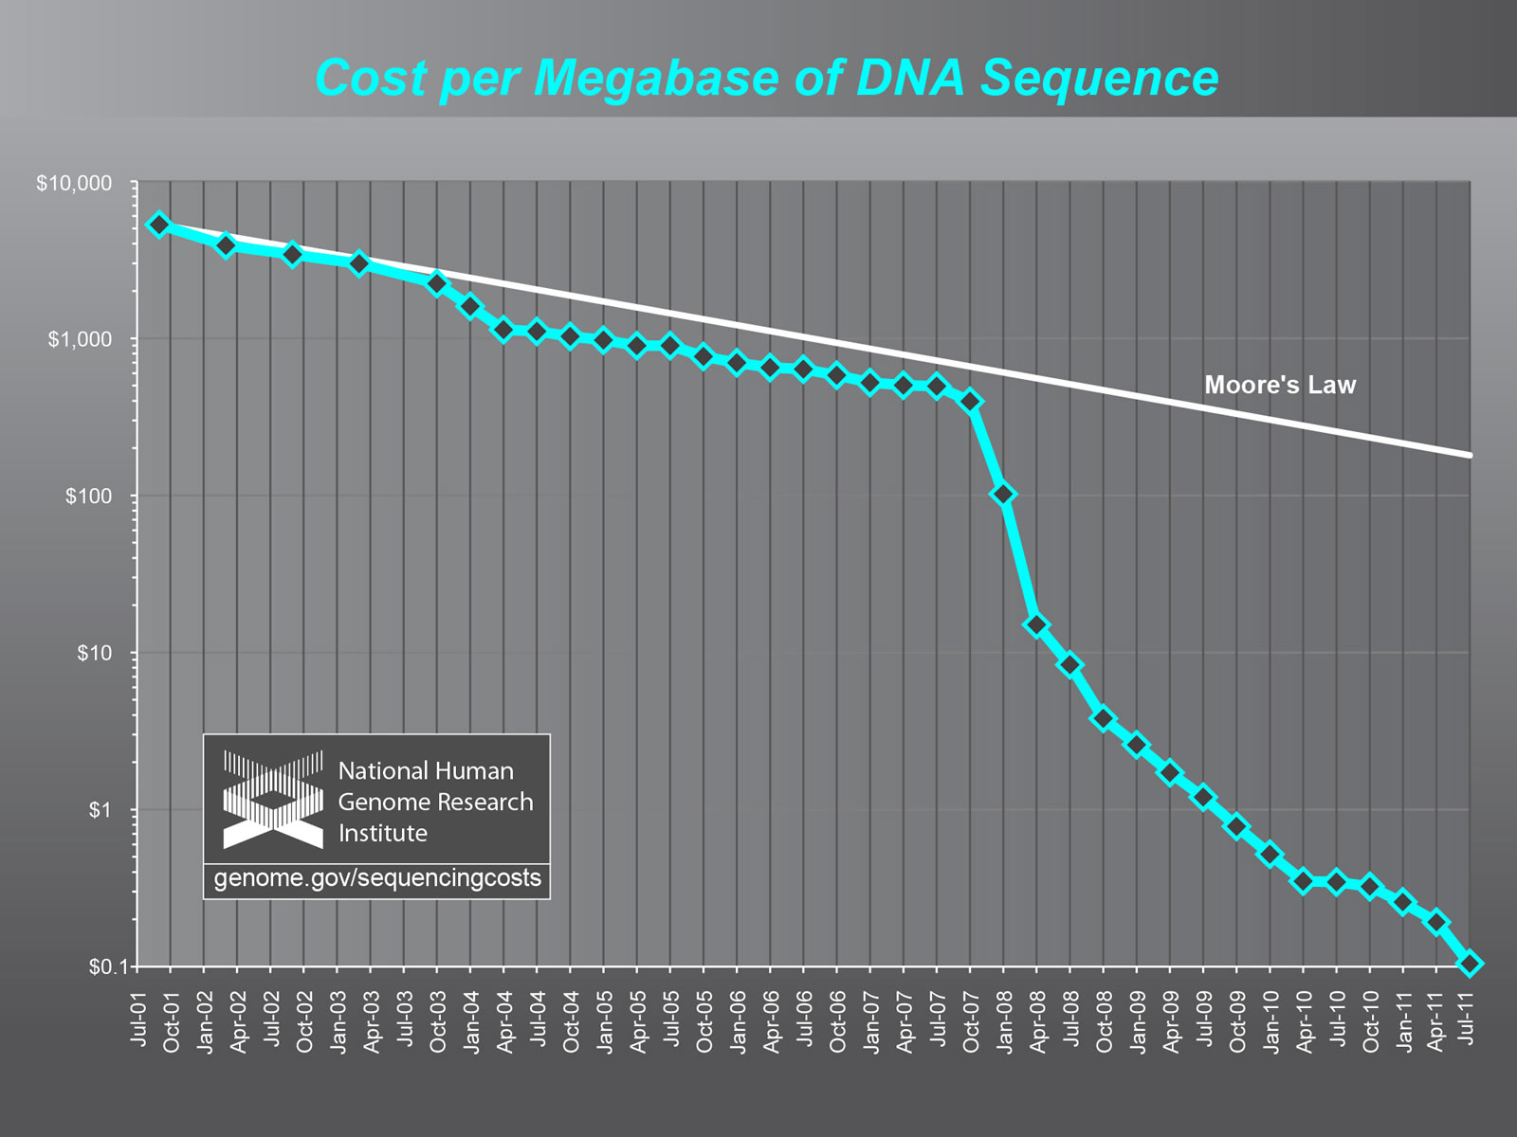
The Data Deluge
~$5,000
in 2001
~10¢
in 2011
Notes:
Early 2008 change in sequencing technology drop dramatic drop in sequencing cost.
Down from several thousand dollars per million nucleotides (at time of human genome project) to now several cents.
Technologies continue to evolve

Slide 3
Sequencing Experiments
De novo assembly
AGCTTCAGATGGACAGATAA
GGCATACAGACTTAGACATA
CCAGACAAGACAGACACAGTA
TACAAGACATAAGCAATACAGA
CCAGACAAGACAGACACAGTA
Genome Assembly
Notes:
What do we use this mountain of sequences for…
Human genome 3 billion nucleotides long, but sequencing read is only 50-100 bp long
Introduce sequencing “read”

Slide 4
Sequencing Experiments
De novo assembly
Re-sequencing
GGCATACAGACTTAGACATA
AGCTTCAGATGGACAGATAA
AGCTTCAGATGGACAGATAA
GGCATACAGACTTAGACATA
CCAGACAAGACAGACACAGTA
CCAGACAAGACAGACACAGTA
CCAGACAAGACAGACACAGTA
TACAAGACATAAGCAATACAGA
TACAAGACATAAGCAATACAGA
CCAGACAAGACAGACACAGTA
Reference Genome
Genome Assembly
Notes:
What do we use this mountain of sequences for…
Human genome 3 billion nucleotides long, but sequencing read is only 50-100 bp long

Slide 5
Sequencing Experiments
De novo assembly
Re-sequencing
Enrichment
GGCATACAGACTTAGACATA
CCAGACAAGACAGACACAGTA
AGCTTCAGATGGACAGATAA
AGCTTCAGATGGACAGATAA
AGCTTCAGATGGACAGATAA
GGCATACAGACTTAGACATA
CCAGACAAGACAGACACAGTA
GGCATACAGACTTAGACATA
CCAGACAAGACAGACACAGTA
CCAGACAAGACAGACACAGTA
CCAGACAAGACAGACACAGTA
TACAAGACATAAGCAATACAGA
TACAAGACATAAGCAATACAGA
TACAAGACATAAGCAATACAGA
CCAGACAAGACAGACACAGTA
Reference Genome
Reference Genome
Genome Assembly
Notes:
What do we use this mountain of sequences for…
Human genome 3 billion nucleotides long, but sequencing read is only 50-100 bp long

Slide 6
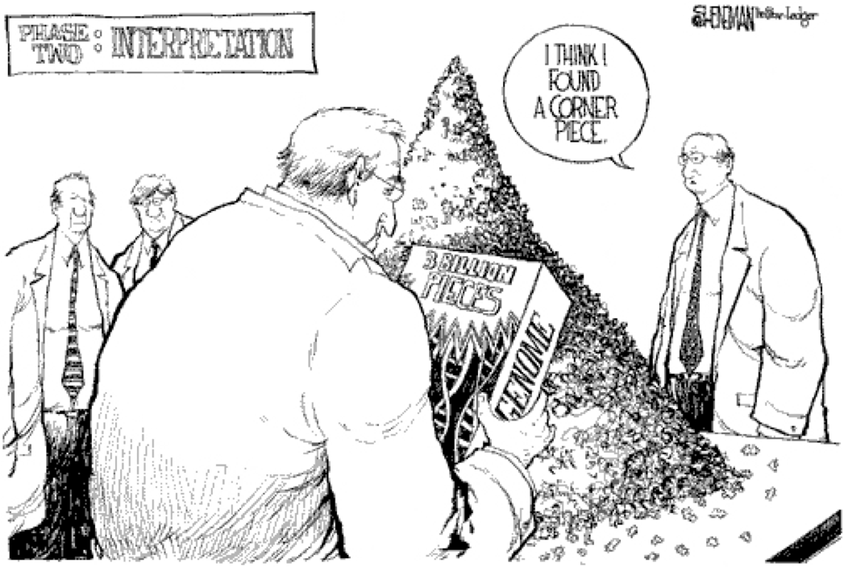
Drew Sheneman, New Jersey - The Newark Star Ledger
Notes:
Results in a mountain of sequence data

Slide 7
Challenge 1
Large number of samples for comparison

Slide 8
Challenge 1
Large number of samples for comparison
“To systematically characterize the genomic changes in hundreds of tumors…and thousands of samples over the next five years”
The Cancer Genome Atlas
www.cancergenome.nih.gov

Slide 9
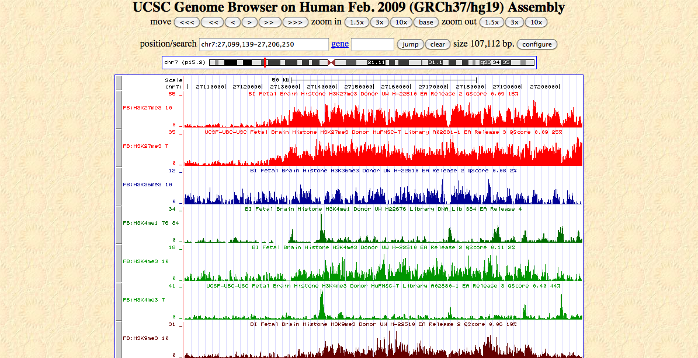
Genome Browsers
Stacked data tracks along a common genome x-axis
Data samples
Genome coordinate

Slide 10
Data samples
Genome coordinate
Zhu et al., Nature Methods, 2009
Notes:
Heatmap representation more condensed view – colour corresponds to some measured numerical value

Slide 11
Challenge 1
Large number of samples for comparison
Consider what information is needed
e.g. replace with biologically meaningful summary, such as significant change between samples

Slide 12
Averages
Zhu et al., Nature Methods, 2009

Slide 13
Challenge 2
Large number of data types

Slide 14
Genomic rearrangements in cancer
Stephens et al., Cell, 2011
Notes:
Pairwise relationships with other genome coordinate on same strand or opposite strand
Have plots of copy number variation or allelic ratio

Slide 15
17 mouse genomes
Keane et al., Nature, 2011
Notes:
We called 0.71M structural variants .100 bp (0.41M simple dele- tions, 0.29M simple insertions, 2,100 inversions, 1,556 copy number gains and 3,658 complex structural variants)
The four wild-derived strains (CAST/EiJ, WSB/EiJ, PWK/PhJ and SPRET/EiJ) are representative of the Mus musculus castaneus, Mus musculus musculus, Mus musculus domesticus and Mus spretus taxa and include the progenitors from which the classical laboratory strains were derived. These genomes are shown in a circle with tracks indicating the relative density of SNPs, structural variants (SVs) and uncallable regions (binned into 10-Mb regions). Transposable element (TE) insertions, which are a subset of the structural variant calls, are shown as a separate track. Corresponding tracks are shown for each of the 13 classical laboratory strains to the right of the circle. Links crossing the circle indicate regions on the reference where the wild- derived strain is closest to the reference (375-kb bins).

Slide 16
Challenge 2
Large number of data types
Compact, customized data encoding
Notes:
Trade-off between scalability and

Slide 17
ABySS-Explorer
Represents sequence
connectivity
strand
length
mapping on reference
Interactively access
sequence coverage
scaffolding
Nielsen et al.
Best Paper Award at InfoVis 2009
Notes:
Trade-off between scalability and simplicity (may require some learning)

Slide 18
Challenge 3
Genomic features are sparse
Notes:
Trade-off between scalability and

Slide 19
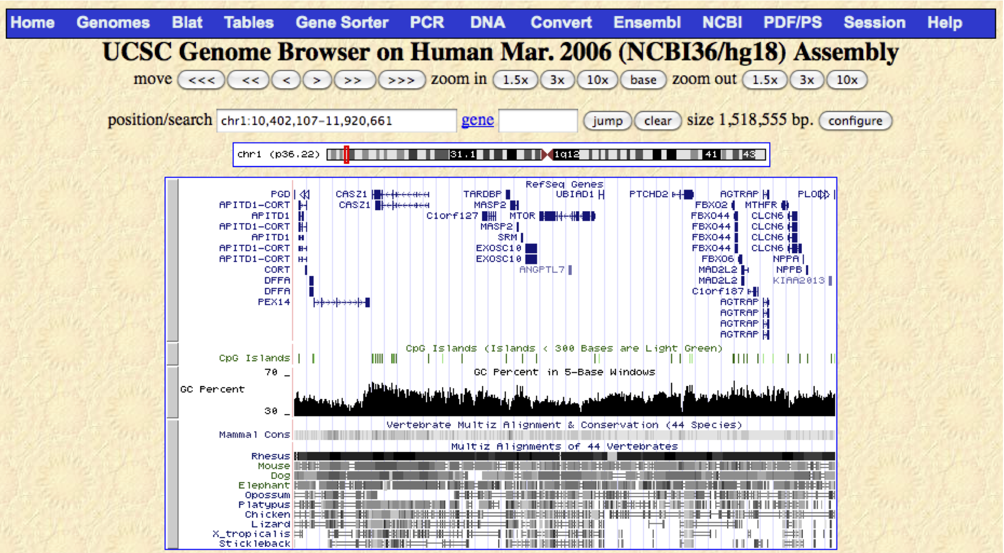
Genome Browsers
LOCAL VIEW

Slide 20
Genome Browsers
LOCAL VIEW
Human chr1, 1 pt corresponds to 480 kb, which is larger than 98% of all human genes!
Notes:
Different image with many similar data tracks
Minimum 1 pt line thickness, 519 pt image width

Slide 21
Hilbert Curve
GLOBAL VIEW
Kharchenko et al., Nature, 2011
Anders, Bioinformatics, 2009
Notes:
But sometimes position on genome is arbitrary (shouldn’t drive the figure)

Slide 22
Challenge 3
Genomic features are sparse
Both overview and detail
Functional axis (perhaps not full genome)
Notes:
Interactivity
Presentation vs. exploration

Slide 23
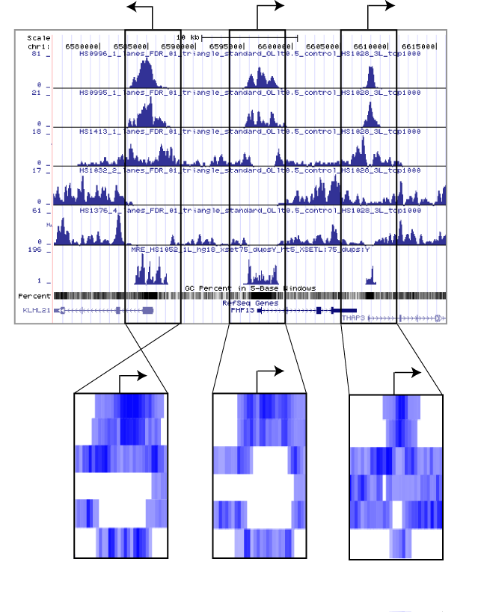
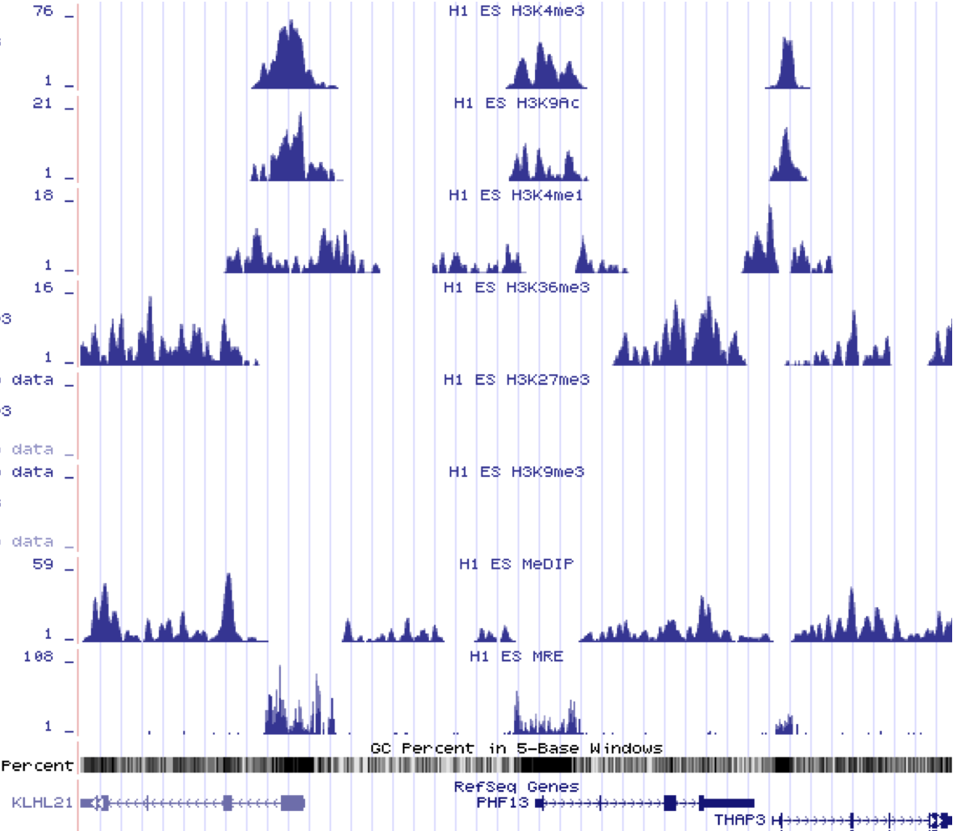

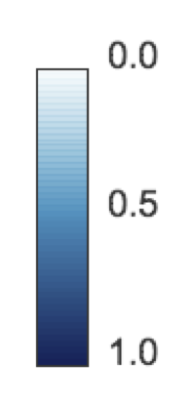



Spark – a genomic data exploration tool
1. Focus on regions of interest (e.g. transcriptional start sites)
H3K4me3
H3K9Ac
H3K4me1
H3K36me3
H3K27me3
H3K9me3
MeDIP
MRE
2. Extract data matrices
3. Cluster matrices
Nielsen et al.
Notes:
Mention what kind of data we’re looking at…

Slide 24
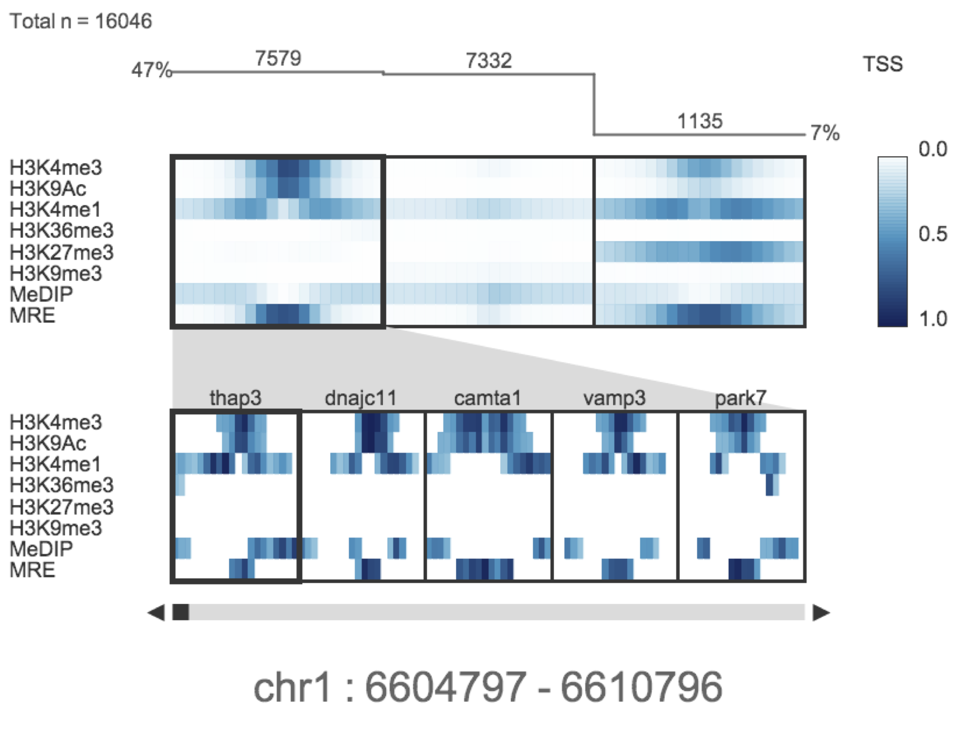
Spark – a genomic data exploration tool
4. Interactive cluster visualization - data from human H1 embryonic stem cells
CLUSTER DISPLAY
REGION BROWSER
Nielsen et al.

Slide 25
Challenge 4
No longer one genome but many

Slide 26
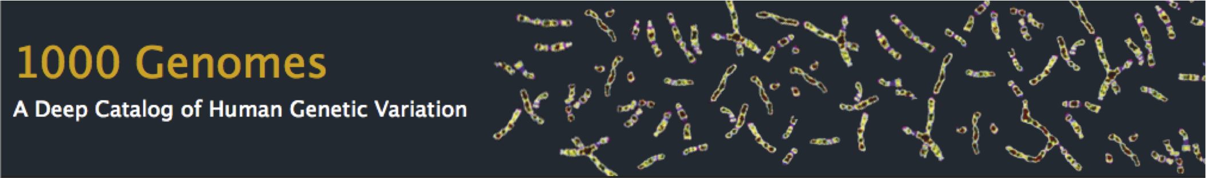
Challenge 4
No longer one genome but many

Slide 27
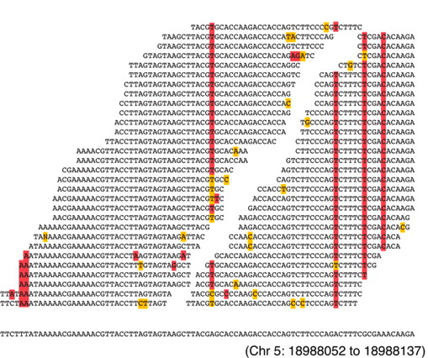
Single nucleotide variation
Ossowski et al. Genome Research, 2008

Slide 28
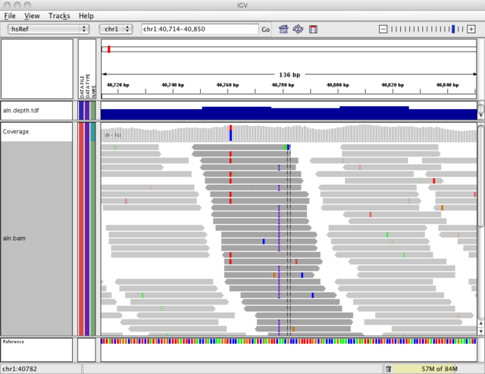
Single nucleotide variation
Integrative Genomics Viewer (IGV)
Robinson et al. Nature Biotechnology, 2011

Slide 29
Structural variation
Bhutkar et al., Genetics, 2008
Notes:
Pairwise information

Slide 30
Challenge 4
No longer one genome but many
Capture variation on a graph

Slide 31
Sequence variation on a graph
Comeau et al., Mol. Biol. Evol., 2010

Slide 32
Sequence variation on a graph
Comeau et al., Mol. Biol. Evol., 2010

Slide 33
Sequence variation on a graph
Paten et al., Genome Research, 2011

Slide 34
Challenge 5
Human
Judgement
Computational
Analysis

Slide 35
Consed Genome Assembly and Finishing Tool
David Gordon and Phil Green
Notes:
Richest example I know is genome “finishing” tools

Slide 36
Challenge 5
Need to integrate computation
High interactivity, low memory overhead
Avoid storing large data sets locally
Popularity of web-based tools
Evolving sequencing technologies
Notes:
Data samples – several gigabytes each

Slide 37
Summary
1
2
3
4
5
Large number of samples for comparison
Large number of data types
Genomic features are sparse
No longer one genome but many
Need to integrate computational analysis

Slide 38





